Slide 1

Double low-rank representation with projection distance penalty for clustering
Zhiqiang Fu, Yao Zhao, Dongxia Chang, Xingxing Zhang, Yiming Wang
Institute of Information Science, Beijing Jiaotong University
Beijing Key Laboratory of Advanced Information Science and Network Technology
Department of Computer Science and Technology, Tsinghua University
Supported by

Slide 2

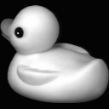


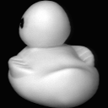

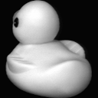

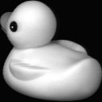



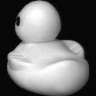





Introduce the clustering
Cluster 1
Without label information
Cluster 2

Slide 3
Introduce the clustering
Clustering
Density based
Distance based
Graph based
DBSCAN
K-means
Meanshift
Ncut
Rcut

Slide 4
Introduce the clustering
Similarity among samples is indispensable
Metric in high-dimensional space is worse
Subspace theory
dimension
curse
Time cost Storage cost
Performance

Slide 5
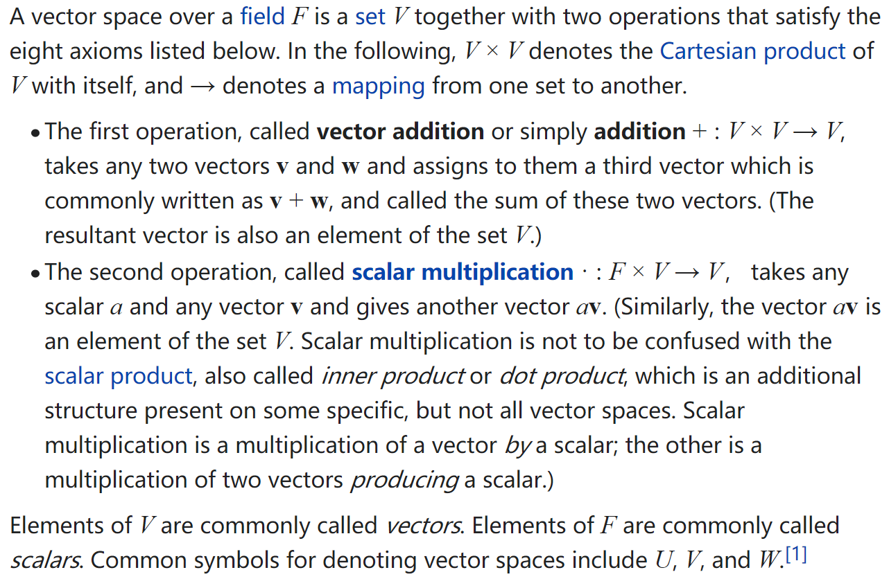
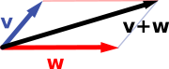
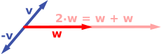
Prior knowledge: linear space

Slide 6
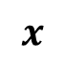
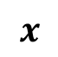
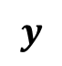
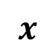
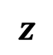
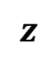
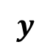
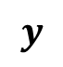
Prior knowledge: subspace and independent subspace
$$z$$
$$z$$
Independent
subspace
Subspace
0
0
$$y$$
$$x$$
0
$$y$$
$$x$$
0
0
$$y$$
$$x$$

Slide 7
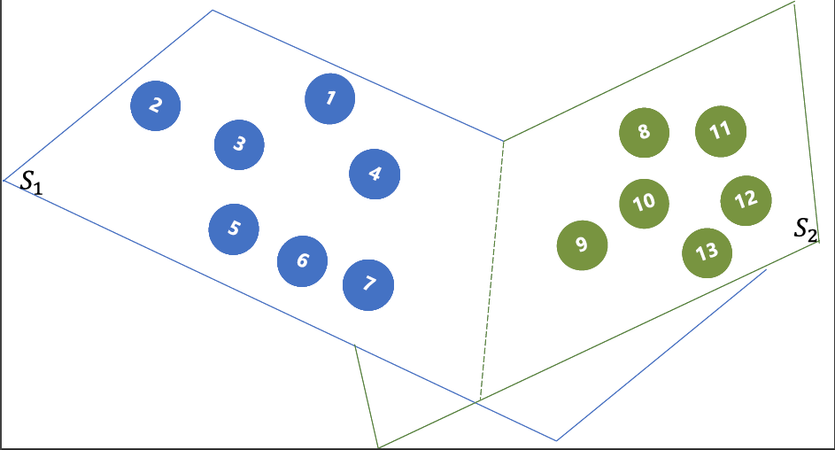
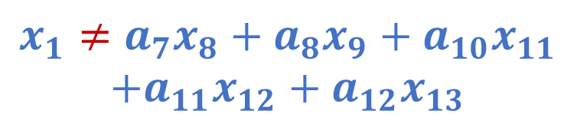
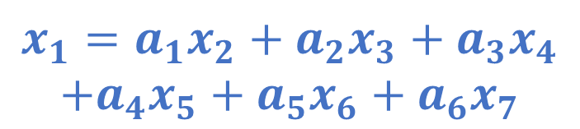
Prior knowledge: subspace and independent subspace
Independent subspace
$$x_{1}=a_{1}x_{2}+a_{2}x_{3}+a_{3}x_{4}$$
$$+a_{4}x_{5}+a_{5}x_{6}+a_{6}x_{7}$$
$$x_{1}≠a_{7}x_{8}+a_{8}x_{9}+a_{10}x_{11}$$
$$+a_{11}x_{12}+a_{12}x_{13}$$

Slide 8
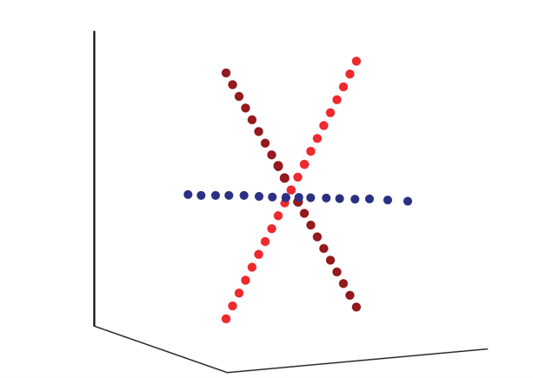
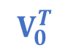
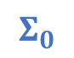
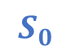

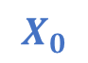

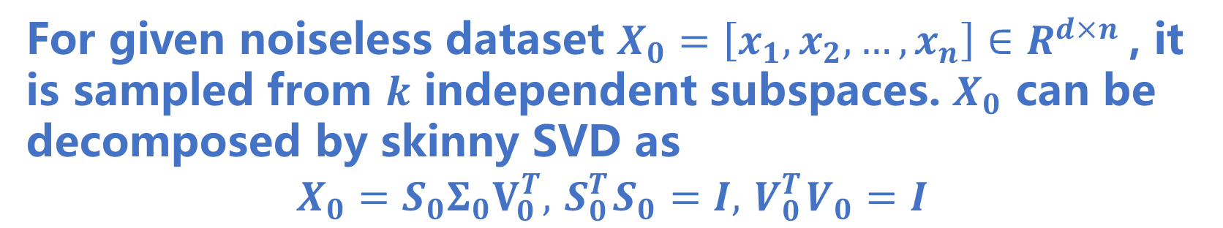
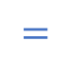
Prior knowledge: basic assumption
For given noiseless dataset $X_{0}=\left[x_{1},x_{2},…,x_{n}\right]∈R^{d×n}$, it is sampled from $k$ independent subspaces. $X_{0}$ can be decomposed by skinny SVD as
$$X_{0}=S_{0}Σ_{0}V_{0}^{T}, { S}_{0}^{T}S_{0}=I, { V}_{0}^{T}V_{0}=I$$
$$X_{0}$$
$$S_{0}$$
$$Σ_{0}$$
$$V_{0}^{T}$$
$$=$$
$$×$$
$$×$$

Slide 9
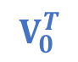

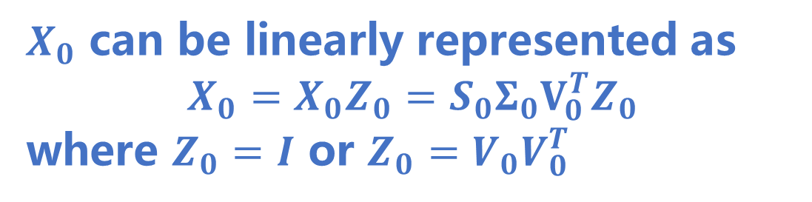
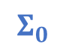
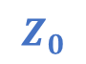

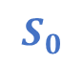

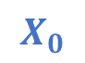



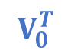
Prior knowledge: basic assumption
$X_{0}$ can be linearly represented as
$$X_{0}=X_{0}Z_{0}=S_{0}Σ_{0}V_{0}^{T}Z_{0}$$
where $Z_{0}=I$ or $Z_{0}=V_{0}V_{0}^{T}$
$$X_{0}$$
$$S_{0}$$
$$Z_{0}$$
$$V_{0}$$
$$Σ_{0}$$
$$V_{0}^{T}$$
$$V_{0}^{T}$$
$$=$$
$$×$$
$$×$$
$$=$$
$$×$$
$$X_{0}=X_{0}Z_{0}=S_{0}Σ_{0}V_{0}^{T}V_{0}V_{0}^{T}=S_{0}Σ_{0}V_{0}^{T}=X_{0}$$

Slide 10
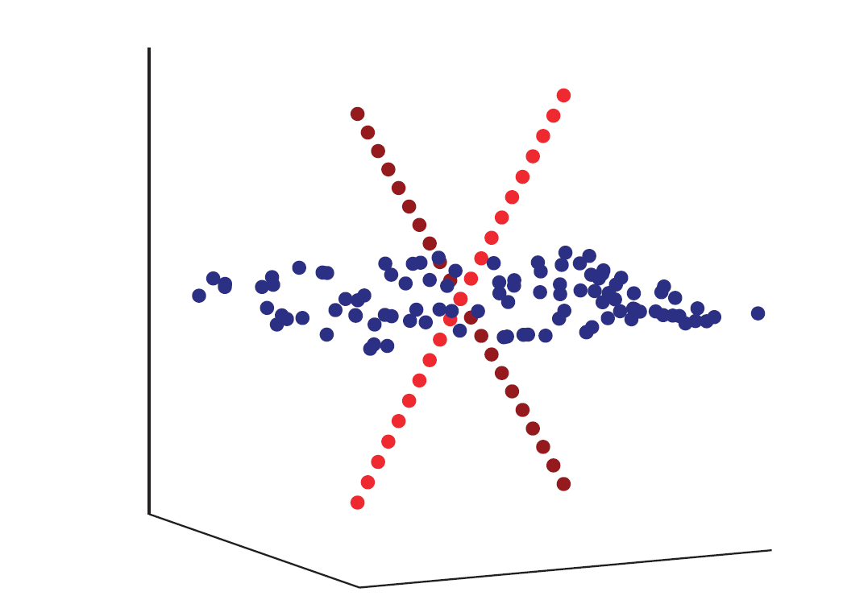
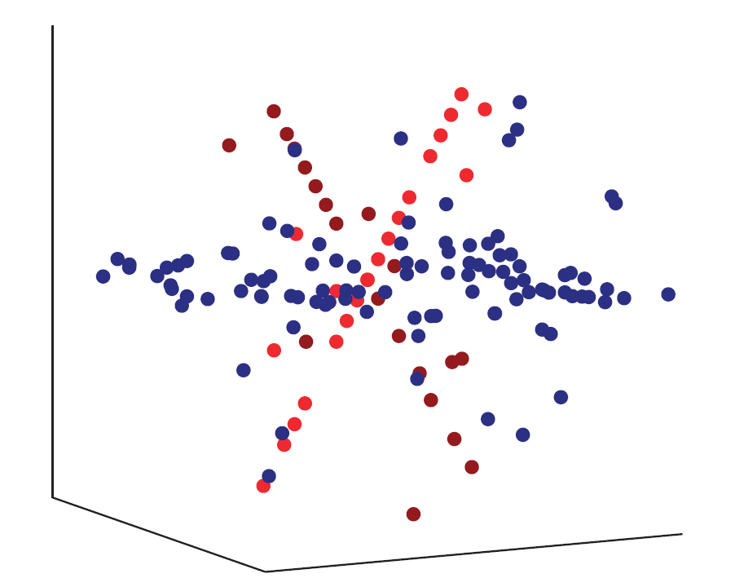


Basic model: Low-rank representation (LRR)
For the noiseless data, the LRR is
$$\min_{Z}||Z||_{∗},s.t.X_{0}=X_{0}Z$$
where $||Z||_{∗}$ is the nuclear norm of $Z$
For data with noise i.e., $X=X_{0}+E_{0}$, a matrix $E$ is introduced
$$\min_{Z}||Z||_{∗}+λ||E||_{2,1},s.t.X=XZ+E$$

Slide 11
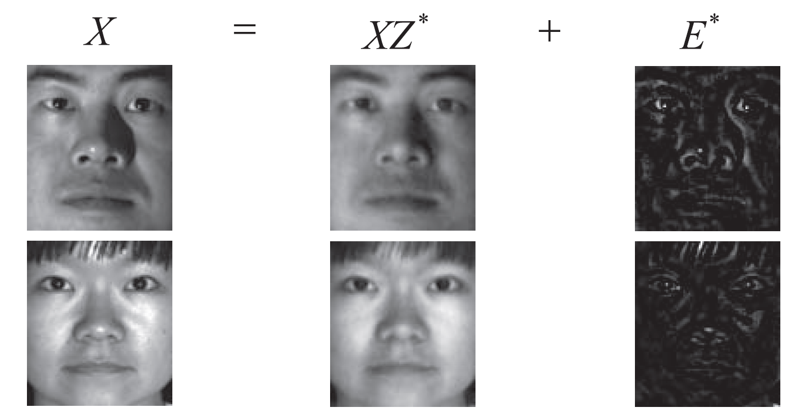
Basic model: LRR

Slide 12



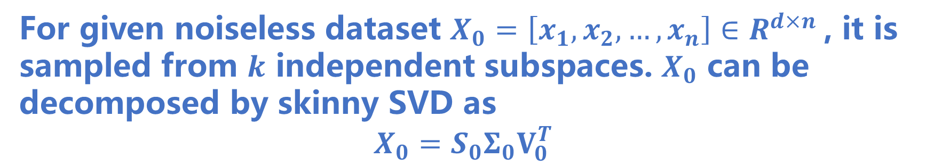





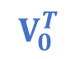
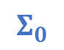
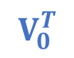




Basic model: Double Low-rank representation (DLRR)
For given noiseless dataset $X_{0}=\left[x_{1},x_{2},…,x_{n}\right]∈R^{d×n}$, it is sampled from $k$ independent subspaces. $X_{0}$ can be decomposed by skinny SVD as
$$X_{0}=S_{0}Σ_{0}V_{0}^{T}$$
$$S_{0}$$
$$S_{0}$$
$$L_{0}$$
$$Z_{0}$$
$$V_{0}$$
$$S_{0}^{T}$$
$$Σ_{0}$$
$$V_{0}^{T}$$
$$V_{0}^{T}$$
$$×$$
$$=$$
$$×$$
$$×$$
$$=$$
$$×$$

Slide 13
Basic model: Double Low-rank representation (DLRR)
$$\min_{Z}||Z||_{∗}+||L||_{∗}+λ||E||_{2,1},s.t.X =LXZ+E$$
Fitting the noise
Learning the structure among features
learning the similarity among the samples

Slide 14

Problems of DLRR
Nuclear norm can capture the global low-rank structure, but ignores the local structure
Local structure
is ignored
Problems

Slide 15

Problems of DLRR
The number of clusters is the only information that we can know in clustering. Taking use of this information can improve the performance.
Class information is not used
Local structure
is ignored
Problems

Slide 16
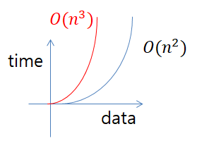

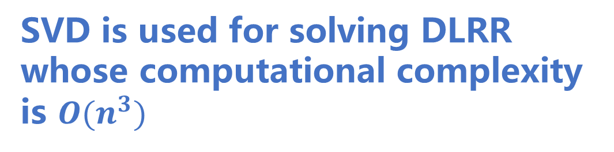
Problems of DLRR
SVD is used for solving DLRR whose computational complexity is $O(n^{3})$
Class information is not used
Local structure
is ignored
Problems
Time cost

Slide 17
DLRRPD:
Double low-rank representation with projection distance penalty

Slide 18
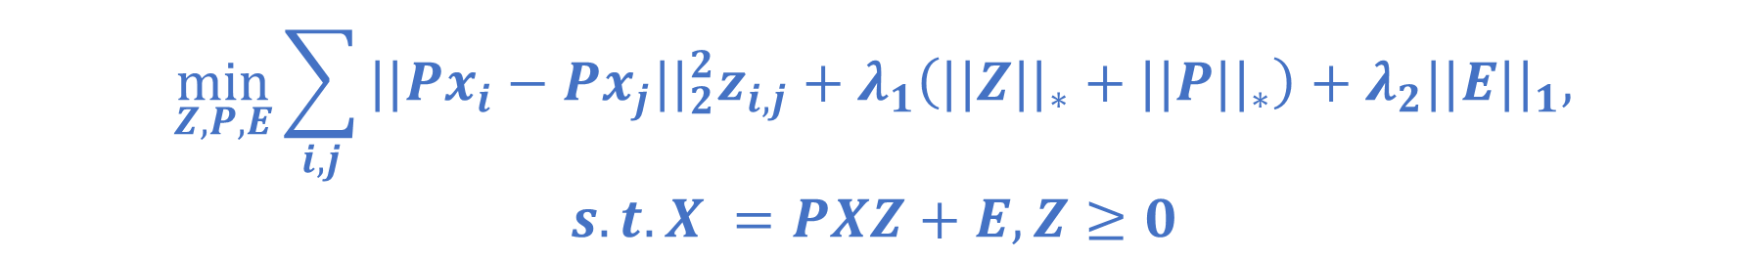
Preserve the local structure
$$\min_{Z,P,E}\sum_{i,j}{||Px_{i}−Px_{j}||_{2}^{2}z_{i,j}}+λ_{1}\left(||Z||_{∗}+||P||_{∗}\right)+λ_{2}||E||_{1},$$
$$s.t.X =PXZ+E,Z≥0$$
where $Px_{i}$is the projection of $x_{i}$

Slide 19

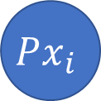
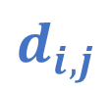
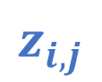


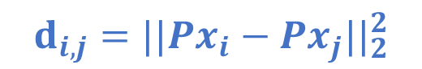
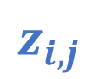
Preserve the local structure
$$\min_{Z,P,E}\sum_{i,j}{||Px_{i}−Px_{j}||_{2}^{2}z_{i,j}}+λ_{1}\left(||Z||_{∗}+||P||_{∗}\right)+λ_{2}||E||_{1},$$
$$s.t.X =PXZ+E,Z≥0$$
where $Px_{i}$is the projection of $x_{i}$
$$d_{i,j}$$
$$z_{i,j}$$
$$Px_{i}$$
$$Px_{j}$$
$$d_{i,j}$$
$$z_{i,j}$$
$$d_{i,j}=||Px_{i}−Px_{j}||_{2}^{2}$$
$$\sum_{i,j}{||Px_{i}−Px_{j}||_{2}^{2}z_{i,j}}=||D⊙Z||_{1}$$

Slide 20
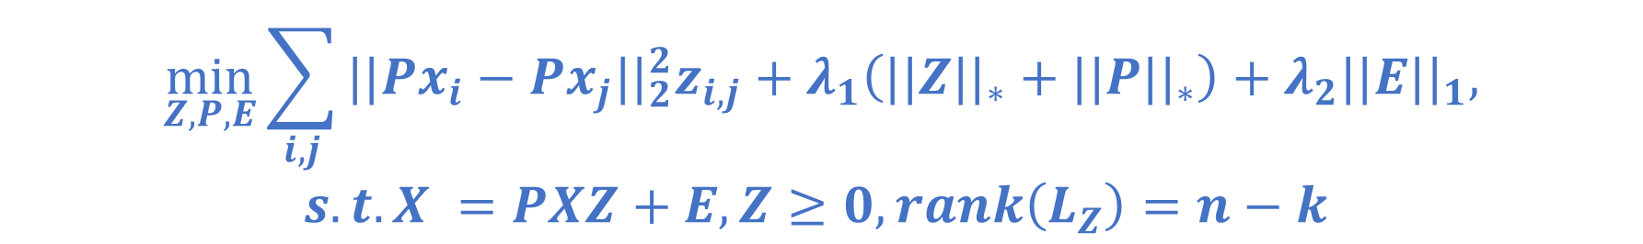

Take use of the number of clusters
$$\min_{Z,P,E}\sum_{i,j}{||Px_{i}−Px_{j}||_{2}^{2}z_{i,j}}+λ_{1}\left(||Z||_{∗}+||P||_{∗}\right)+λ_{2}||E||_{1},$$
$$s.t.X =PXZ+E,Z≥0,rank\left(L_{Z}\right)=n−k$$
where $L_{z}$is the Laplacian matrix of $Z$
$rank\left(L_{Z}\right)=n−k$ can ensure that there are $k$ connected components

Slide 21
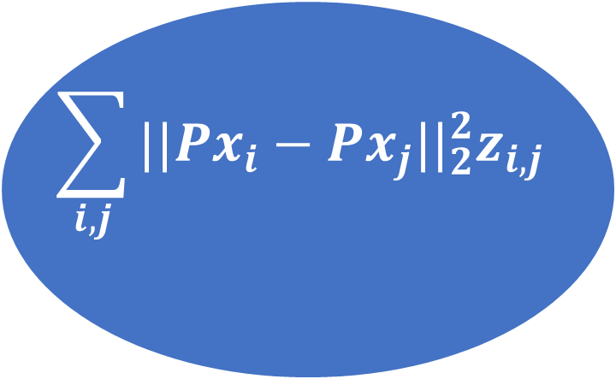


Take use of the number of clusters
Better projection $P$ can enhance the representation $Z$
$$\sum_{i,j}{||Px_{i}−Px_{j}||_{2}^{2}z_{i,j}}$$
$$rank\left(L_{Z}\right)=n−k$$
Better representation $Z$ can be used as information
to learn better projection $P$

Slide 22


Reduce the computational complexity
$$\min_{Z,P,E}\sum_{i,j}{||Px_{i}−Px_{j}||_{2}^{2}z_{i,j}}+λ_{1}\left(||Z||_{∗}+||P||_{∗}\right)+λ_{2}||E||_{1},$$
$$s.t.X =PXZ+E,Z≥0,rank\left(L_{Z}\right)=n−k$$
Frobenius norm is another convex surrogate of low-rank constraint
$$\min_{Z,P,E}\sum_{i,j}{||Px_{i}−Px_{j}||_{2}^{2}z_{i,j}}+\frac{λ_{1}}{2}\left(||Z||_{F}^{2}+||P||_{F}^{2}\right)+λ_{2}||E||_{1},$$
$$s.t.X =PXZ+E,Z≥0,rank\left(L_{Z}\right)=n−k$$

Slide 23



Some additional constraint
$$\min_{Z,P,E}\sum_{i,j}{||Px_{i}−Px_{j}||_{2}^{2}z_{i,j}}+\frac{λ_{1}}{2}\left(||Z||_{F}^{2}+||P||_{F}^{2}\right)+λ_{2}||E||_{1},$$
$$s.t.X =PXZ+E,Z≥0,rank\left(L_{Z}\right)=n−k, z_{i,i}=0, Z1=1$$
$$z_{i,i}=0$$
$$Z1=1$$

Slide 24

Convergence curve

Slide 25

Computational time cost

Slide 26

Experimental results on synthetic dataset
Nearby samples may mislead the method

Slide 27

Experimental results on real dataset

Slide 28

Experimental results on real dataset

Slide 29

Experimental results on real dataset

Slide 30

Experimental results on noisy dataset

Slide 31

Experimental results on noisy dataset

Slide 32

Experimental results on noisy dataset

Slide 33

Experimental results on noisy dataset

Slide 34

Experimental results on noisy dataset

Slide 35

Experimental results on noisy dataset

Slide 36

Parameter sensitivity and selection

Slide 37
Thanks for watching
The paper and the source code can be obtained from Github as
https://github.com/fuzhiqiang1230/DLRRPD
zhiqiangfu@bjtu.edu.cn

